Slide 1
CS 447/647
Web Hosting

Slide 2
Overview
What are the two most popular open-source HTTP servers?
What are the components of a web application? (HTTP, UWSGI, Rev-Proxy...)
What is a URL?
What are the HTTP verbs (transactions)?
What are common HTTP responses?
What are the parts of an HTTP request?

Slide 3
Web Hosting
Linux and *NIX are the dominant platforms for serving WWW
67% of the top one million sites
Open-source is 80% of the web server software market
Web applications are a set of components
Static content
Dynamic content
Databases
Cloud infrastructure
Provision quickly
Simplifies design and deployment

Slide 4
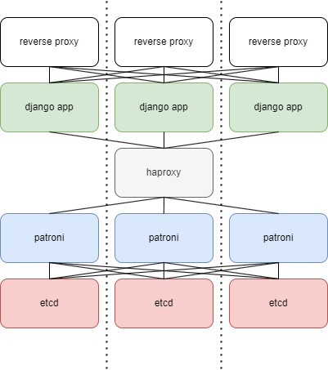

Slide 5
HyperText Transfer Protocol
Core application level protocol for the web
Essential for all Sysadmins
DevOps, SWEs, SREs too
Client/Server Architecture
One Request - One Response
Typical web page needs multiple requests
Adapts slowly
It’s popularity makes changes high stakes
Wasn’t always this way…
https://thehistoryoftheweb.com/the-origin-of-the-img-tag/
Notes:
Marc Andreessen, still an undergraduate there, alongside Eric Bina at the University of Illinois. 18 HTML elements
An img tag ran against their visions for the WWW. Shouldn’t it be image not img. Release it first. First to market
1995 included in the HTML 2.0 spec

Slide 6
HyperText Transfer Protocol
HTTP Versions 1.0 & 1.1
Plain text protocol
telnet google.com 80
GET /index.html
HTTP/2 (no longer) under development
Backwards compatible
Performance Improvements
Only TLS-encrypted
Binary Format
HTTP/3 under development
Notes:
Marc Andreessen, still an undergraduate there, alongside Eric Bina at the University of Illinois. 18 HTML elements
An img tag ran against their visions for the WWW. Shouldn’t it be image not img. Release it first. First to market
1995 included in the HTML 2.0 spec

Slide 7
Uniform Resource Locators (URLs)
Defines how and where to access a resource
Not unique to HTTP
FTP, SMB, git ssh
Pattern for URL is scheme:address
Scheme is a protocol
Address is the resource
mailto:zestreito@unr.edu
smb://storage.unr.edu
Microsoft: \\storage.unr.edu\

Slide 8
URLs
Address Structure
scheme://[username:password@]hostname[:port][/path][?query][#anchor]
Username and password are HTTP Basic Authentication
Bad idea because URLs are logged
Not encrypted by default
Hostname is a domain name or IP
Port is the TCP port. Defaults 80 and 443
Query is a set of key value pairs
key=value
Anchor is a subtarget of a URL.
<h1 id=”Intro>Introduction </h1>

Slide 9
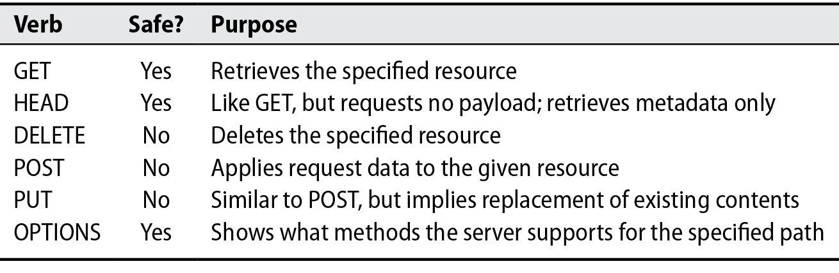
HTTP Transactions
HTTP requests
First line is the action then path
GET /index.php HTTP/1.1

Slide 10
HTTP request methods
GET - Most common verb followed by POST
POST vs PUT
PUT should be idempotent
Server that send mails should use POST
PUT used for APIs
DELETE
Often used with APIs
OPTIONS
Bots
https://couchdb.apache.org/

Slide 11
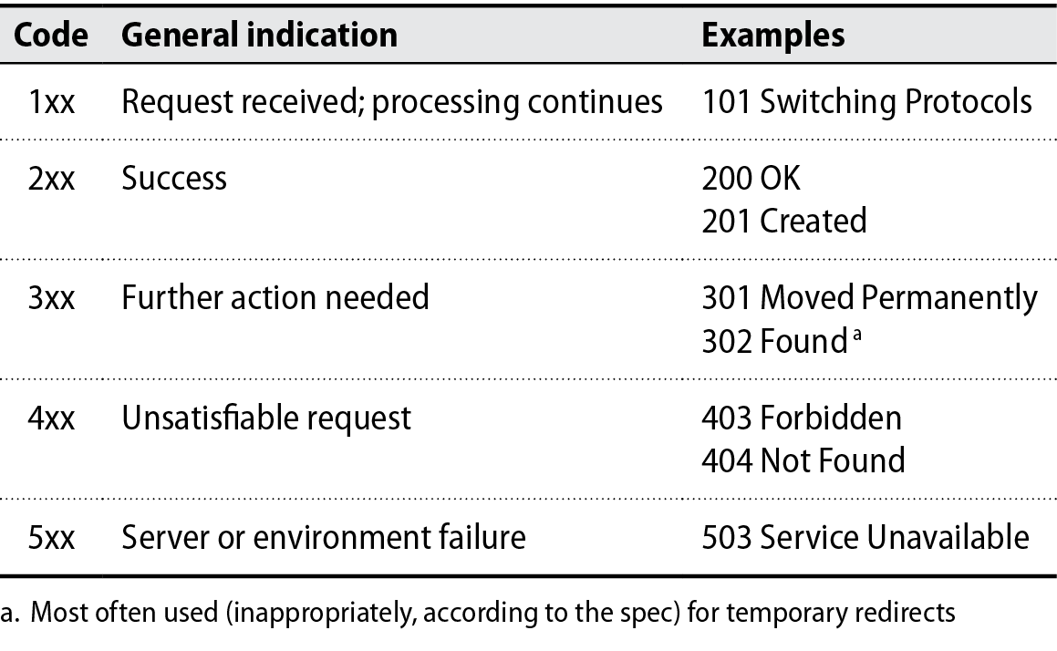
HTTP Responses

Slide 12
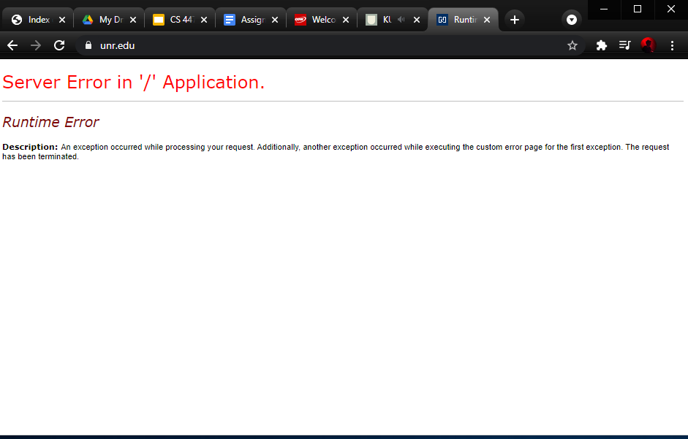

Slide 13
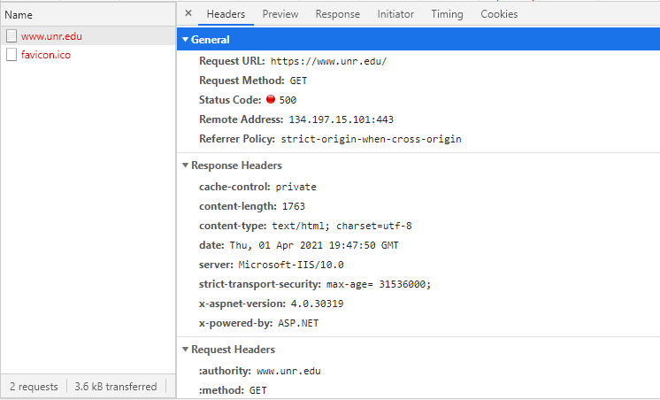

Slide 14
418 I'm a teapot
“Any attempt to brew coffee with a teapot should result in the error code "418 I'm a teapot". The resulting entity body MAY be short and stout.” Hyper Text Coffee Pot Control Protocol (HTCPCP/1.0)

Slide 15
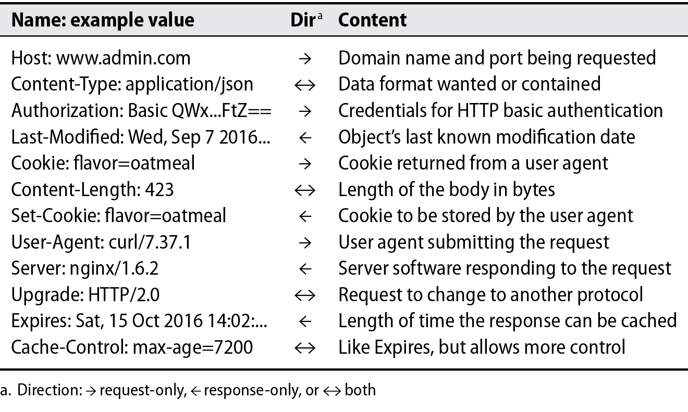
Headers and Message Body

Slide 16
Headers
Headers are separate from the body
Body can be text, binary or blank
curl -i \ -H "Accept: application/json" \ -H "Content-Type: application/json" \ http://host/resource

Slide 17
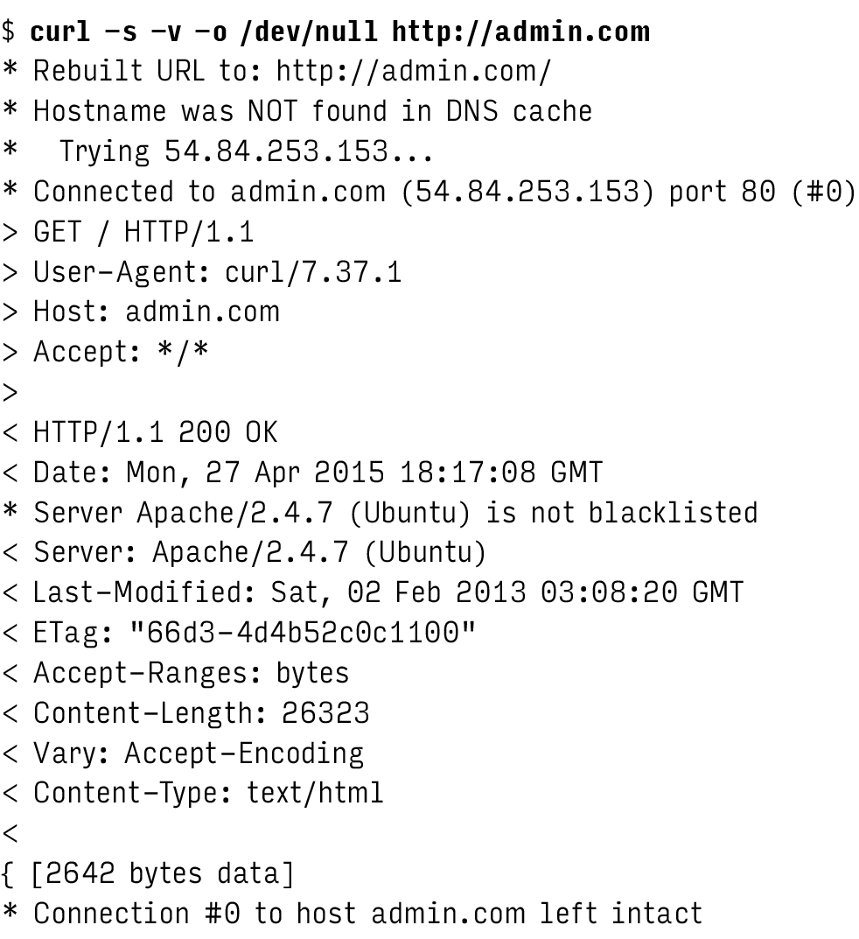
curl - HTTP from the command line

Slide 18
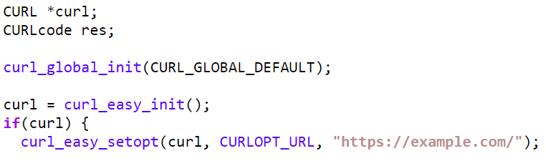
curl
libcurl
client-side URL transfer library
DICT, FILE, FTP, FTPS, Gopher, HTTP, HTTPS, IMAP, IMAPS, LDAP, LDAPS, POP3, POP3S, RTMP, RTSP, SCP, SFTP, SMTP, SMTPS, Telnet and TFTP

Slide 19
curl Examples
curl https://www.google.com/accounts/ClientLogin \ --data-urlencode Email=brad.gushue@example.com \ --data-urlencode Passwd=new+foundland \ -d accountType=GOOGLE \ -d source=Google-cURL-Example \ -d service=lh2
curl -X DELETE http://couch.db/index/resource
Notes:
HTTP Post

Slide 20
TCP connection reuse
TCP connections are expensive
3-way handshake before request
At Least 7 packets
Average site has 99 resources per page
New connection for each would be slow
“Connection: Keep-Alive” header allows reuse
Multiple requests over one connections
Non-trivial performance hit
Servers must maintain thousands of connections
HTTP/2 introduces multiplexing
Multiple transactions on a single connection
Lower overhead

Slide 21
HTTP over TLS
HTTP Provides no network-level security
URLs, Headers and payload are open
Transport Layer Security runs between HTTP and TCP
Encryption and authentication
TLS replaced Secure Socket Layer (SSL)
SSL deprecated
Assume SSL means TLS
TLS verifies the server’s identity (domain name)
Certificate Authorities (ca-certificates)

Slide 22
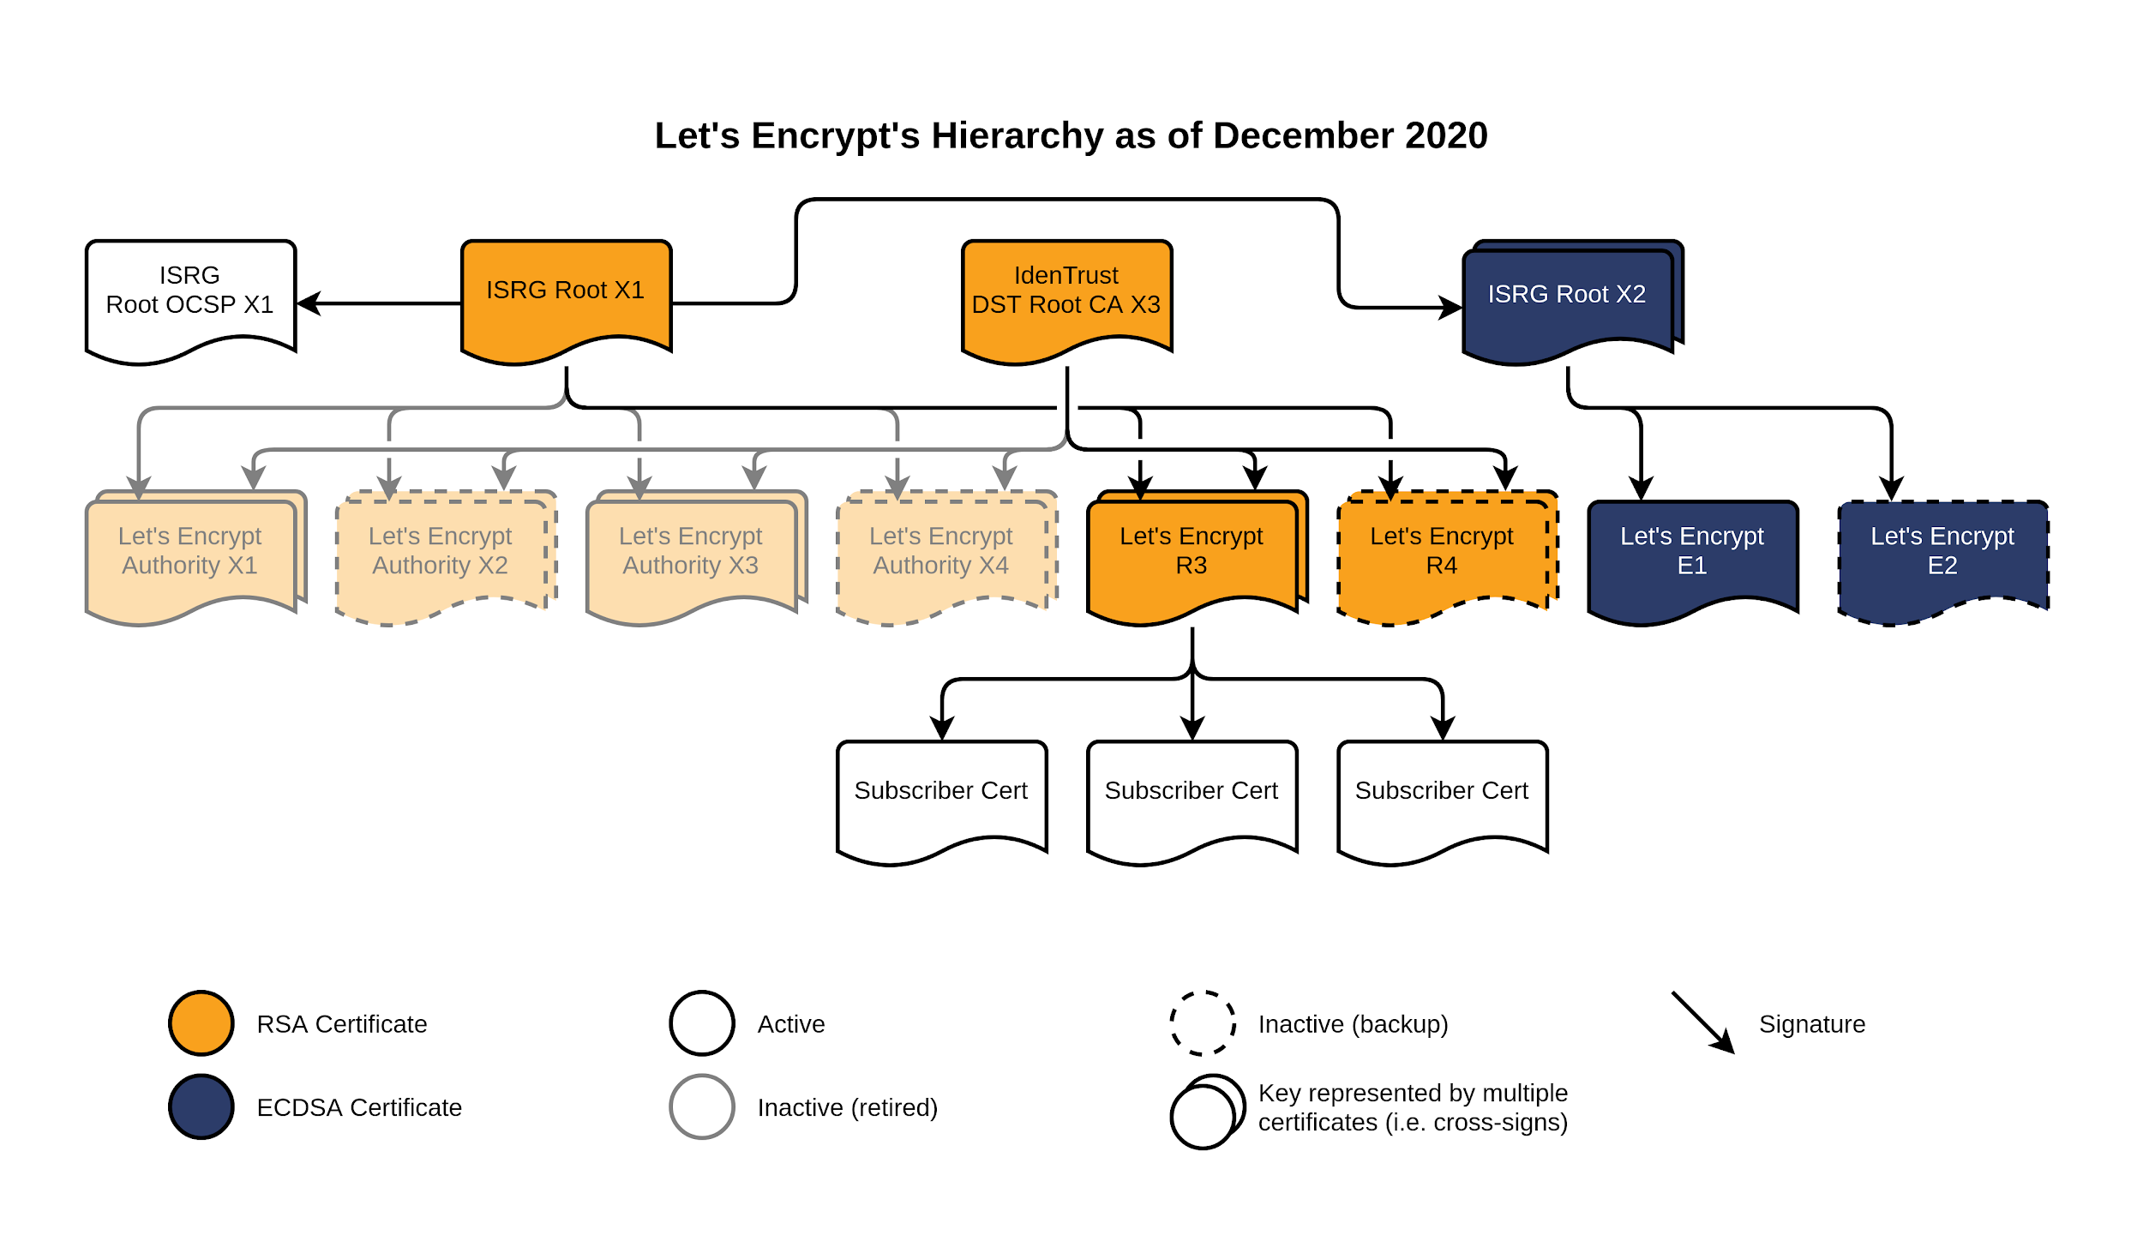
Certificate Authorities
https://letsencrypt.org/certificates/

Slide 23
Virtual hosts
Many domain names, one server
A records
CNAME records
RFC2616 - Host header
Server examines the header
Required in HTTP 1.1
Issues with TLS
TLS session required before Host header submitted
Server Name Indication (SNI) adds hostname to initial TLS message

Slide 24
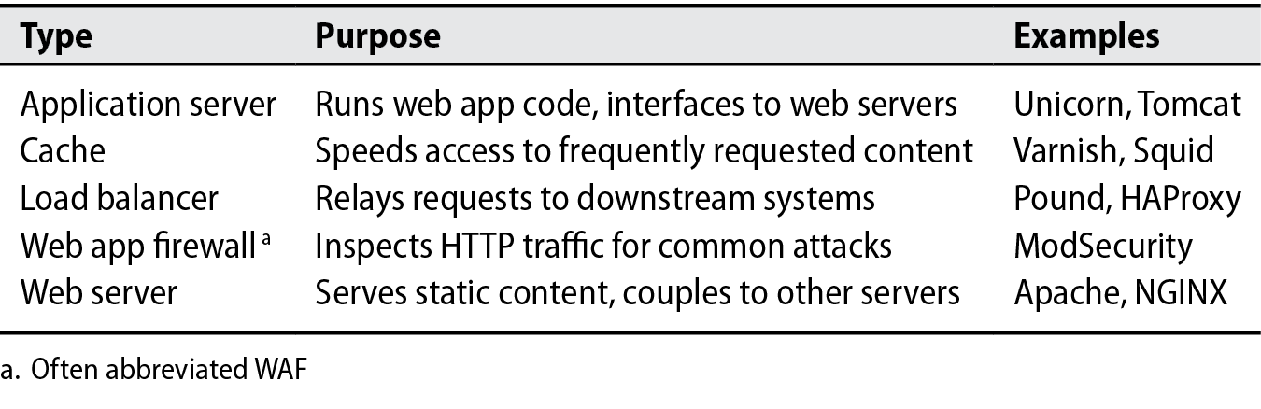
Web Software

Slide 25
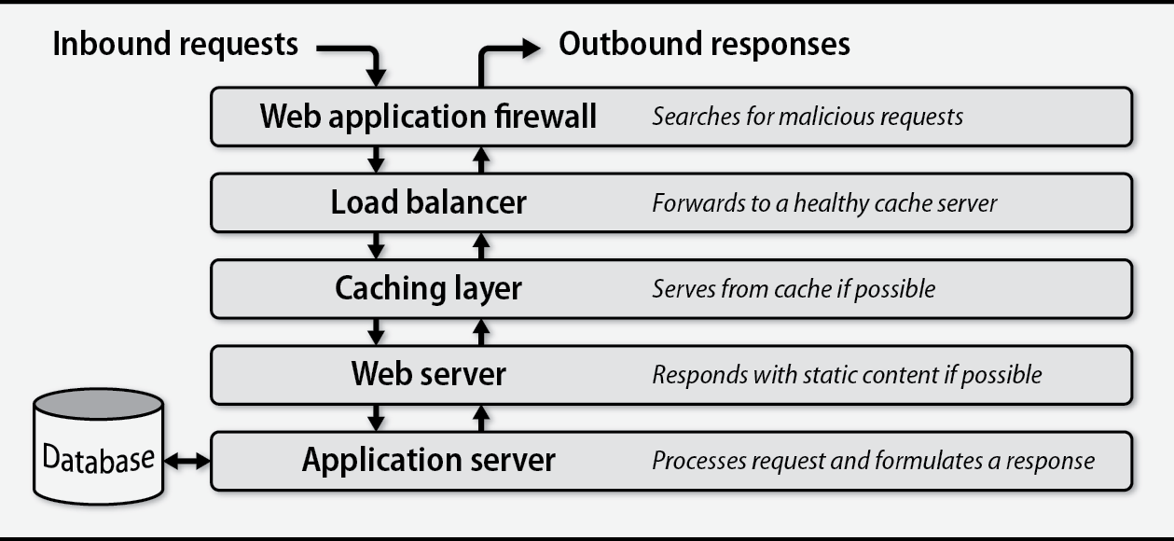
Web Software

Slide 26
Web Servers and Proxies
Web Server Content
Static content
Dynamic content
Web Server Features
Virtual Hosts
Handling TLS
Logging requests and responses
HTTP basic authentication
Routing to downstream systems
Execution of Dynamic content

Slide 27
Web Servers
Popular servers
NGINX
20% of websites
Fairly new
High-performance, event-based
apache2
46 % of websites
Released in 1995
Reference HTTP implementation
Needs significant tweaking to get high performance
Multi-Processing Module pre-forking
IIS
Windows Web Server

Slide 28
Load balancers
Route requests to other systems
Handle lots of concurrent requests
Allows you to drain resources
Easily remove a server from rotation
Health check mechanism can remove a server from rotation
HTTP 50x responses
Typically run in pairs
Passive backup
Virtual IP
Load Balancing algorithms
Round robin - distributed in fixed order across servers
Load equalization - new request go to server with least connections
Partitioning - Server selected based on a client's request
Notes:
a type of proxy server that distributes incoming requests among a set of downstream web servers.
Load balancers also monitor the status of those servers to ensure that they are providing timely and correct responses.

Slide 29
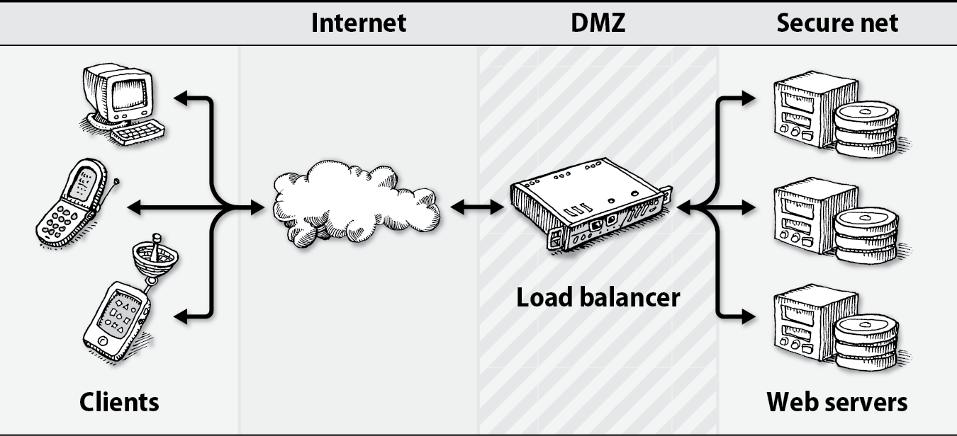
Load balancers
Notes:
a type of proxy server that distributes incoming requests among a set of downstream web servers.
Load balancers also monitor the status of those servers to ensure that they are providing timely and correct responses.

Slide 30
Load balancers
TLS Termination
Backend WWW server won’t need HTTPs
Distribute other traffic
SQL
Common load balancers
nginx
HAProxy
F5
Amazon Elastic Load Balancer (ELB)

Slide 31
Caches
Clients frequently access the same content
CSS, Images, SQL queries
Adds complexity
Stale content
curl -H "Cache-Control: no-cache"

Slide 32
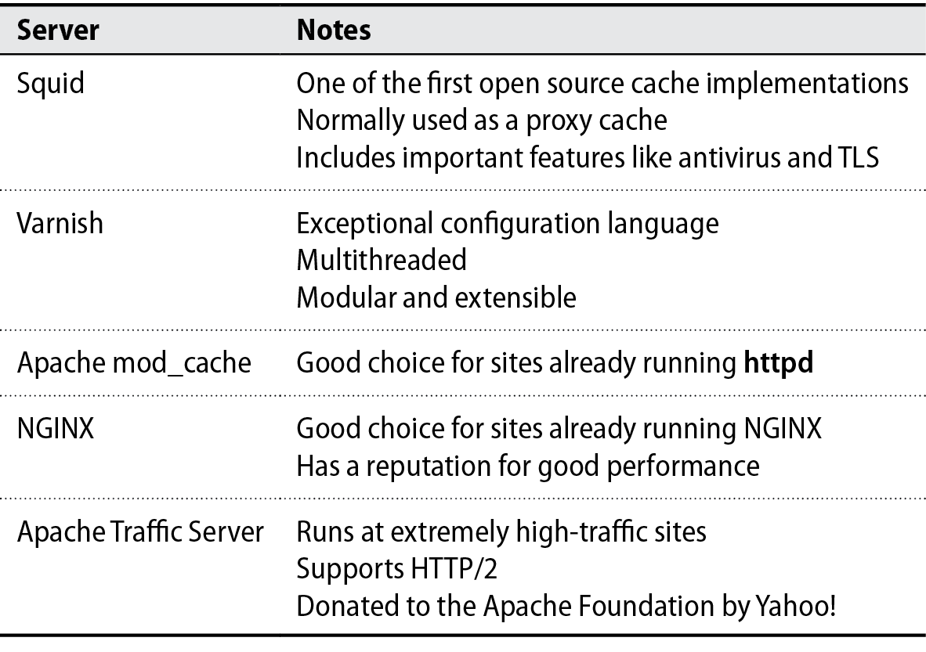

Slide 33
Content Delivery Networks
Global distributed system for content
Improves web performance
Content is closer to users
Youtube
Traditionally for static content
Images, CSS and javascript
Requests to a CDN are routed to closest server
Edge servers are like proxy caches

Slide 34
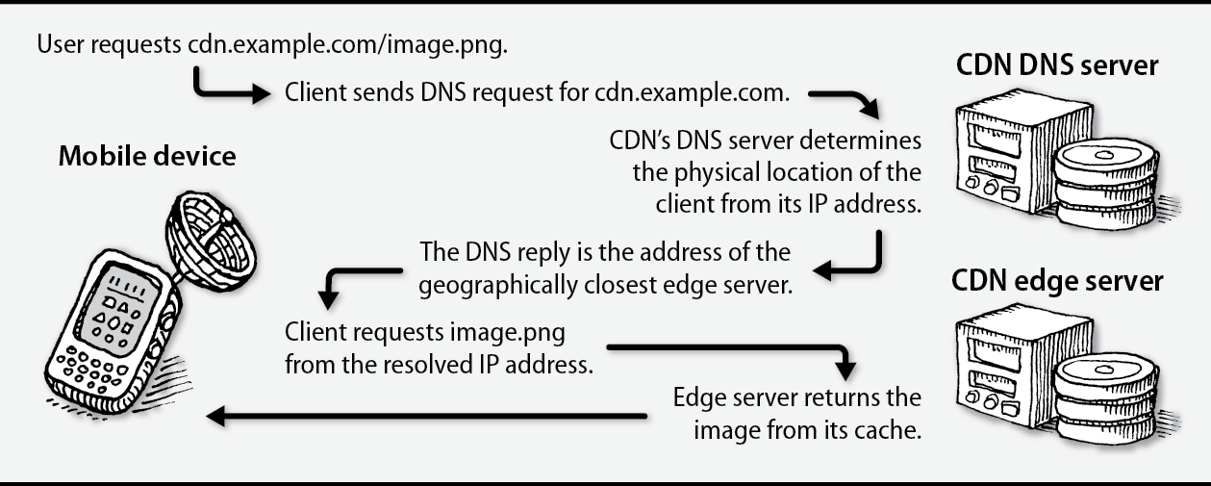

Slide 35
Content Delivery Networks
Examples:
<script src="https://ajax.googleapis.com/ajax/libs/d3js/5.15.0/d3.min.js"></script>
<script src="https://ajax.googleapis.com/ajax/libs/jquery/3.4.1/jquery.min.js"></script>
<link rel="stylesheet" href="https://maxcdn.bootstrapcdn.com/bootstrap/3.3.7/css/bootstrap.min.css" integrity="sha384-BVYiiSIFeK1dGmJRAkycuHAHRg32OmUcww7on3RYdg4Va+PmSTsz/K68vbdEjh4u" crossorigin="anonymous">
Notes:
Cross-Origin Resource Sharing (CORS) is a mechanism that uses additional HTTP headers to tell browsers to give a web application running at one origin, access to resources at another origin.

Slide 36
Languages of the web
Ruby - Ruby-on-Rails
Python - Django, Flask
Java - Grails
Node.js - Server-side Javascript
PHP - Personal Home Page, Wordpress, Drupal, CakePHP
Go - Google’s lower-level language
.NET - Microsoft’s framework, ASP.NET MVC, C#

Slide 37
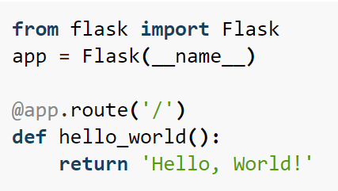
Flask

Slide 38
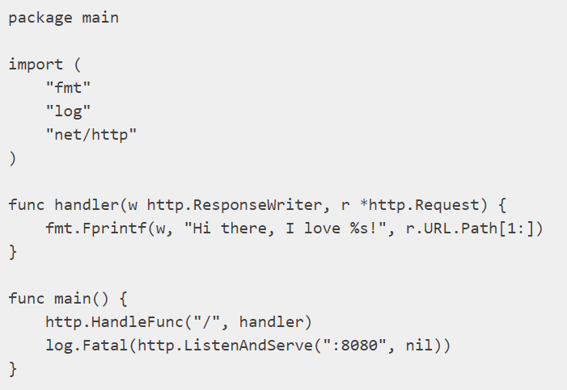
Go

Slide 39
Application Programming Interfaces (APIs)
Intended for software agents
python3-requests
Exposed to the world
Promote use by eternal developers
Use normal HTTP Requests
Text-based Serialization
JSON - Can’t be used for evil
XML

Slide 40
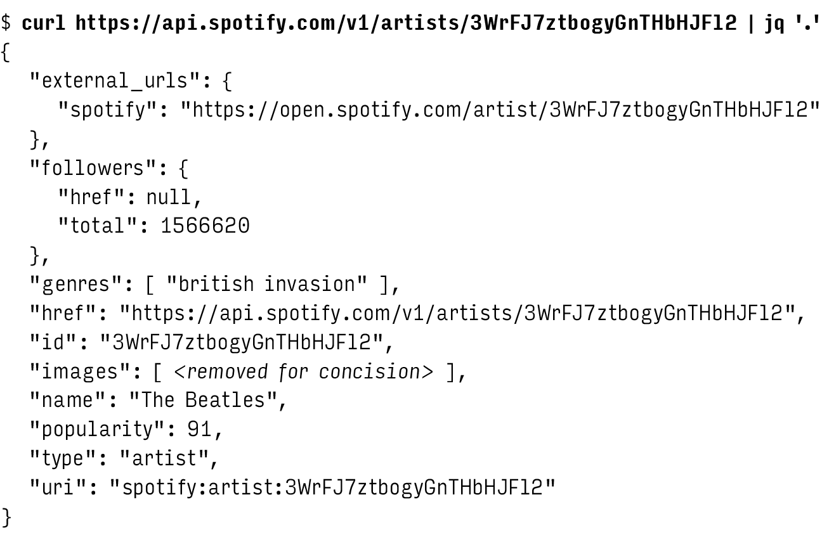
API Example

Slide 41
API Types
REST - Representational State Transfer
Typically JSON
Canvas - /api/v1/users/:user_id/courses
SOAP - “Simple” Object Access Protocol
Complex XML based format
Few URLs, Large Requests, Poor Performance
Microsoft..

Slide 42
Web hosting in the cloud
Lots of providers
Google, Amazon, Microsoft, Linode
Platform as a service - AppEngine
VMS - Linode
Build vs Buy
Raw VMS
Hybrid - AWS Load-Balancer with VMS’
Avoid DIY unless it’s a core competency
Static Sites
Google Firebase - Copy and Paste

Slide 43
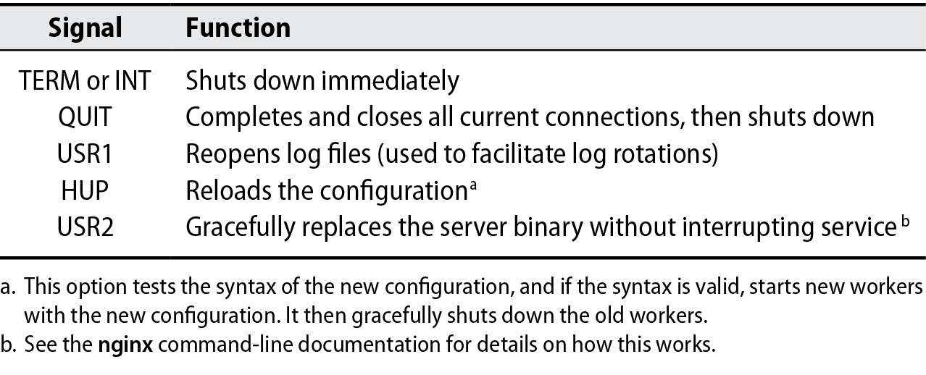
nginx
Install
apt install nginx-extras
extras = Standard HTTP, Optional, Mail and 3rd Party
FastCGI, SSL, IMAP, PAM
Uses signals for some housekeeping

Slide 44
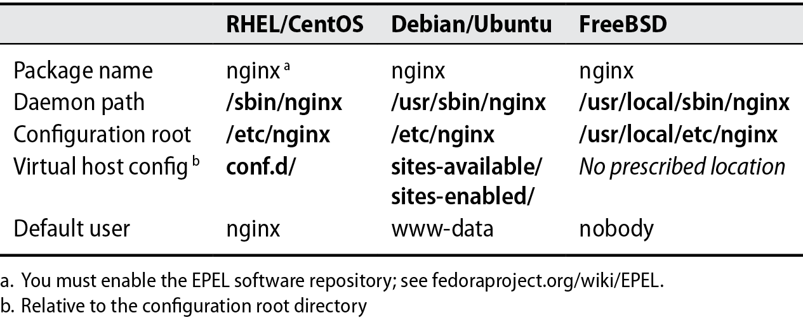
Configuring nginx

Slide 45
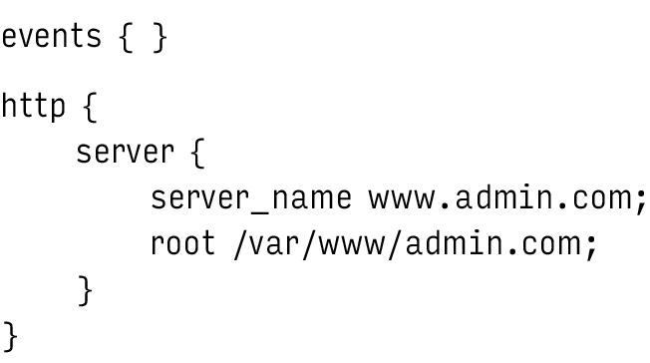
Configuring nginx
Contexts {}

Slide 46
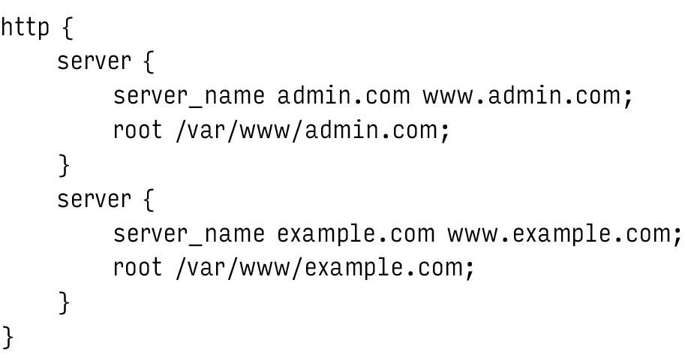
Configuring nginx

Slide 47
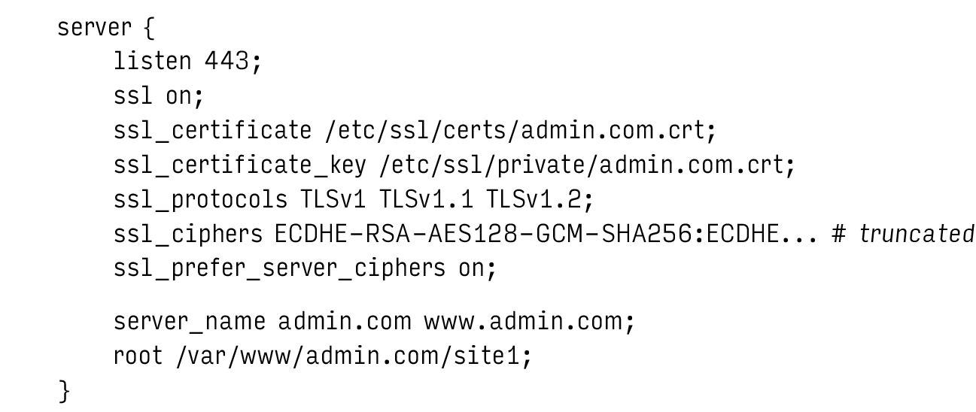
Configuring TLS

Slide 48
Configuring headers
location / { proxy_set_header Host $host; proxy_set_header X-Real-IP $remote_addr; proxy_set_header X-Forwarded-For $proxy_add_x_forwarded_for; proxy_set_header X-Forwarded-Host $server_name; set_by_lua $client_cert "return ngx.var.ssl_client_raw_cert and ngx.var.ssl_client_raw_cert:gsub('\\n',' ') or nil"; uwsgi_param X-SSL-CERT $ssl_client_raw_cert;
}

Slide 49
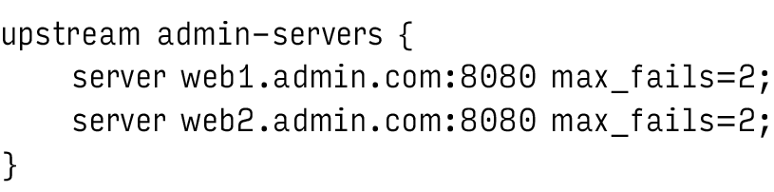
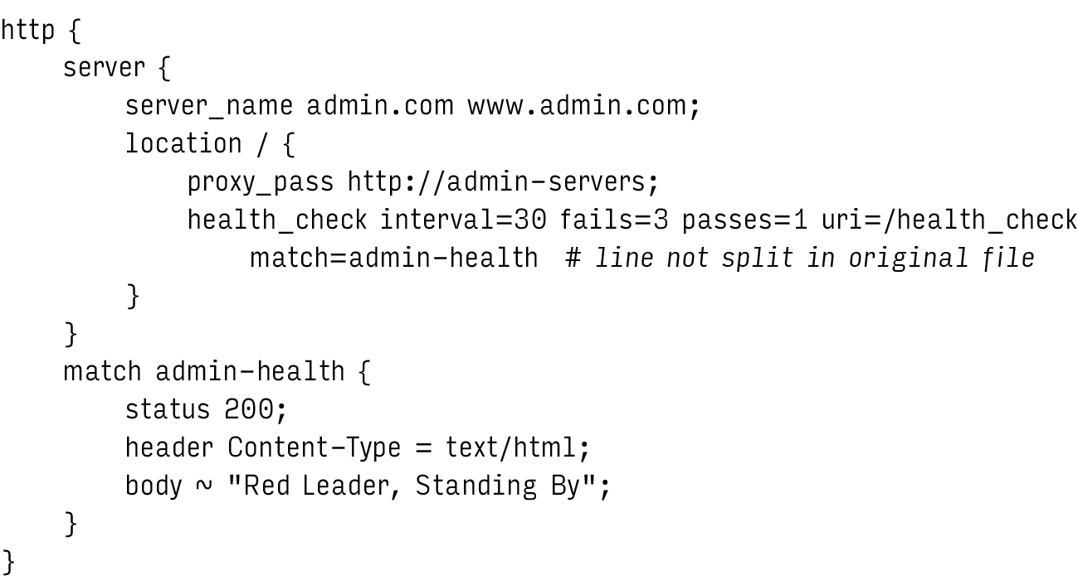

Slide 50
Reverse Proxying
Nginx serves static content and load balances
Web Server Gateway Interface (WSGI) handles dynamic content
Python, Ruby, Perl

Slide 51
Forward Proxy
Internet facing proxy
Clients configure it as a middleman
Fetches resources for the client
Proxy Auto-Configuration(PAC)
Javascript function for matching URL patterns to a proxy server

Slide 52
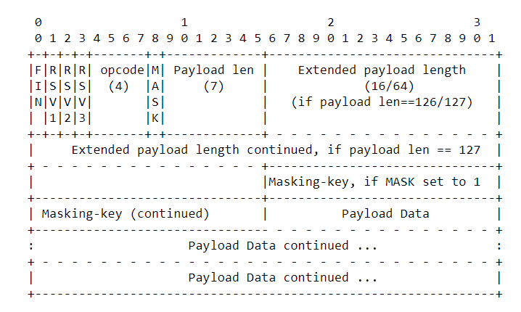
Web Sockets
2011 Google RFC6455
Bidirectional
Framing Protocol
ws-URI = "ws:" "//" host [ ":" port ] path [ "?" query ] wss-URI = "wss:" "//" host [ ":" port ] path [ "?" query ]

